Slide 1
SHIFTing pro-environmental behaviors through choice architecture
David J. Hardisty
Associate Professor
Sauder School of Business
University of British Columbia
Vancouver, BC, Canada
Notes:
Workshop title: Facilitating Environmental Decisions using Choice Architecture: New lessons from the lab and field

Slide 2
Katherine White Rishad Habib David J. Hardisty Jiaying Zhao
White, K., Habib, R., & Hardisty, D. J. (2019). How to SHIFT consumer behaviors to be more sustainable: A literature review and guiding framework. Journal of Marketing, 83(3), 22-49.
Habib, R., White, K., Hardisty, D. J., & Zhao, J. (2021). Shifting Consumer Behavior to Address Climate Change. Current Opinion in Psychology, 42, 108-113.
Notes:
https://dibs.sauder.ubc.ca

Slide 3
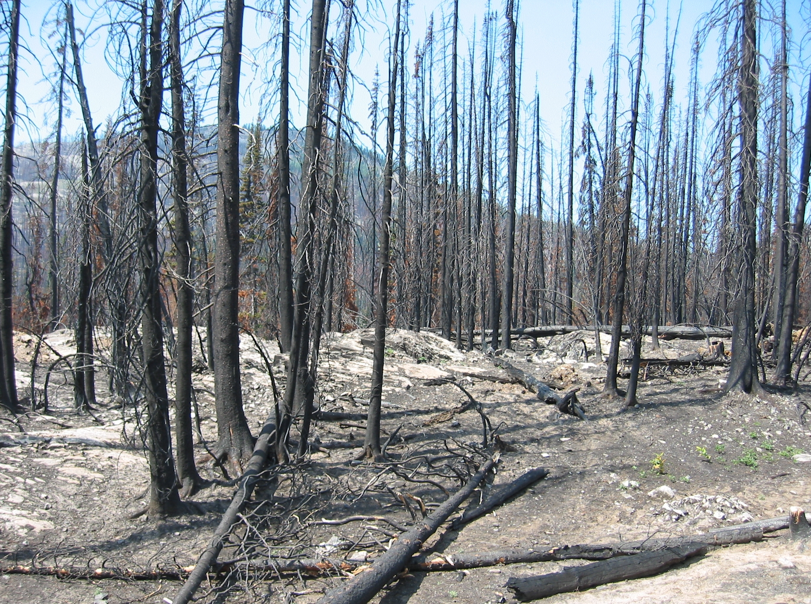
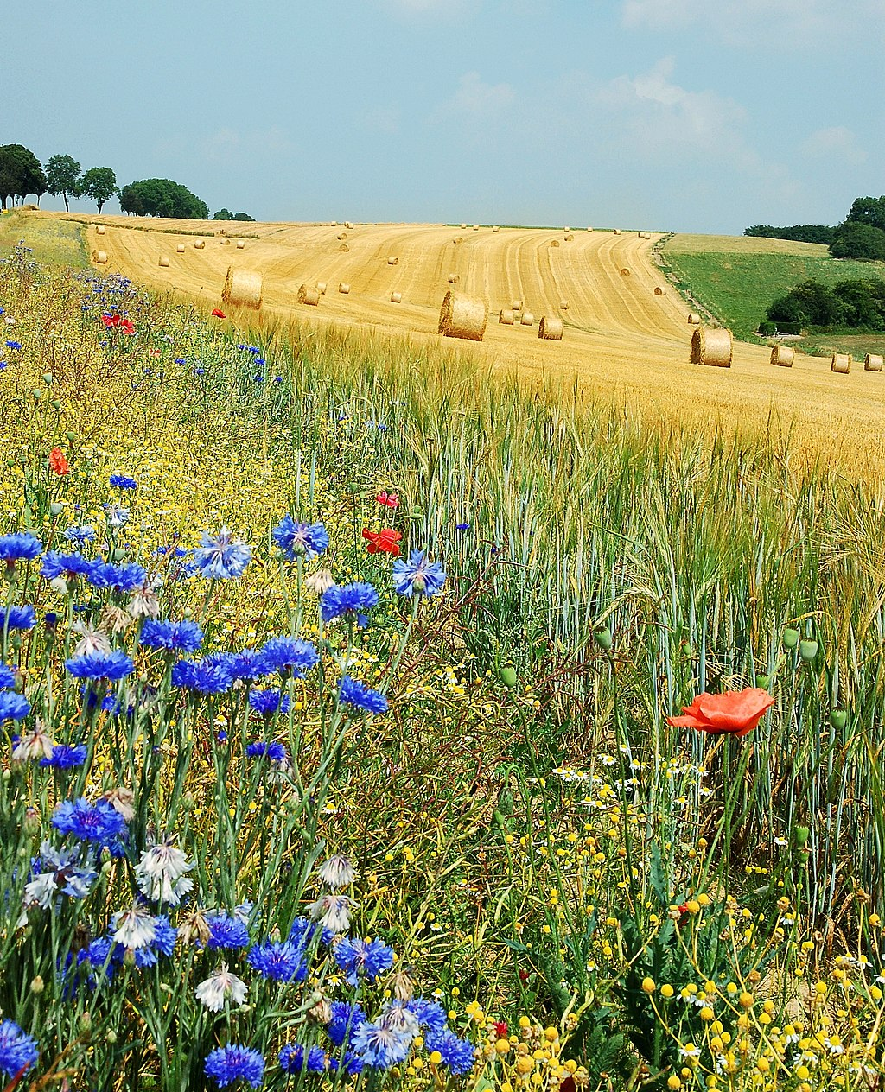
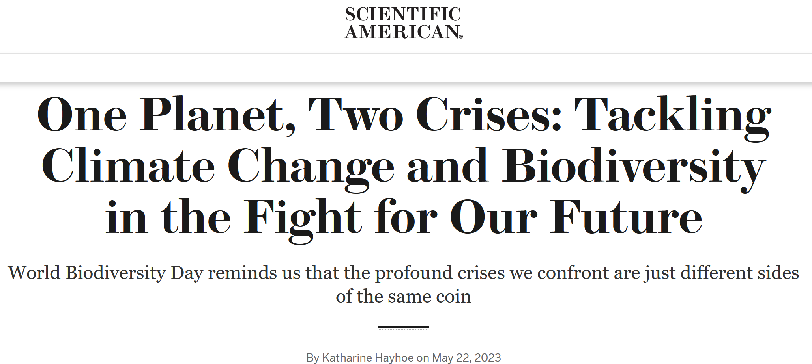
Notes:
Left image: https://commons.wikimedia.org/wiki/File:Forest_fire_aftermath.jpg
Right image: https://commons.wikimedia.org/wiki/File:Field_Hamois_Belgium_Luc_Viatour.jpg

Slide 4
Sustainability goals continue to grow
Stated support for sustainability is high, and products with sustainability claims show twice the growth of their traditional counterparts
But there is still an intention-action gap
65% want to support companies with a strong purpose, yet only about 26% actually rewarded companies for their behavior

Slide 5
We reviewed over 320 academic articles to create a framework with the following 5 psychological routes to shifting sustainable behaviors.
Notes:
0

Slide 6
OCIAL INFLUENCE
The attitudes, expectations, and behaviors of others play a large role in how consumers behave, particularly in the context of engaging in pro-environmental actions.
Social Norms
Social Desirability
Social Group Membership

Slide 7
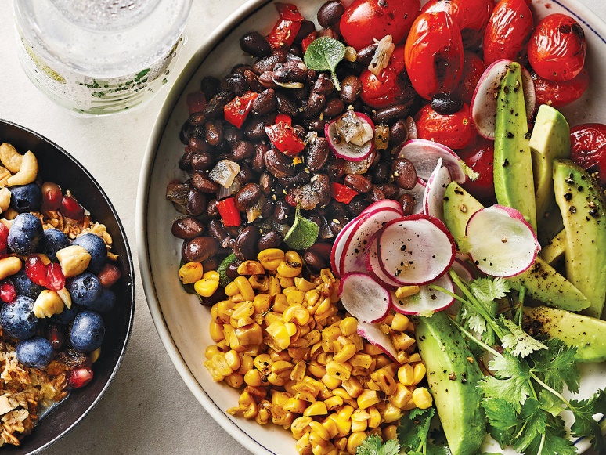
OCIAL INFLUENCE
The attitudes, expectations, and behaviors of others play a large role in how consumers behave, particularly in the context of engaging in pro-environmental actions.
Communicating dynamic norms regarding the increase in people limiting meat consumption over the last 5 years doubled the chances of participants ordering a meatless lunch at a campus cafeteria.
G. Sparkman, L. Howe, G. Walton, How social norms are often a barrier to addressing climate change but can be part of the solution, Behav. Public Policy. (2020) 1–28. https://doi.org/10.1017/bpp.2020.42.
Notes:
Compared to sharing the % of people limiting meat consumption, sharing the increase in people doing so

Slide 8
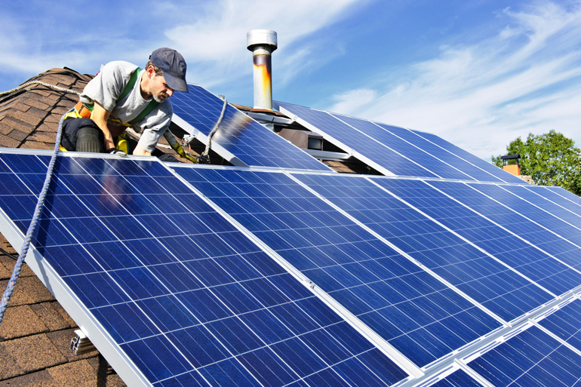
OCIAL INFLUENCE
The attitudes, expectations, and behaviors of others play a large role in how consumers behave, particularly in the context of engaging in pro-environmental actions.
A field study with 1.4 million people monitoring solar panel installation showed that ambassadors who themselves installed solar panels were able to recruit 62.8% more residents
Kraft-Todd, Gordon T., Bryan Bollinger, Kenneth Gillingham, Stefan Lamp, and David G. Rand (2018), “Credibility-Enhancing Displays Promote the Provision of Non-normative Public Goods,” Nature, 563, 245–48.
Notes:
Followed up with controlled lab studies

Slide 9
ABITS
Habits are automatic, relatively uncontrolled behaviors that are easy for people to perform.
Break bad habits
Discontinuity
Penalties
Form new good habits
Make it easy
Prompts
Incentives
Feedback

Slide 10
ABITS
Habits are automatic, relatively uncontrolled behaviors that are easy for people to perform.
Context changes make it harder to act automatically & easier to change habits
One study shows that recent movers who were also environmentally concerned reduced car use from 64% of the time to 37%
Verplanken, Bas, Ian Walker, Adrian Davis, and Michaela Jurasek (2008), “Context Change and Travel Mode Choice: Combining the Habit Discontinuity and Self-Activation Hypotheses,” Journal of Environmental Psychology, 28(2), 121–127.

Slide 11
ABITS
Habits are automatic, relatively uncontrolled behaviors that are easy for people to perform.
Defaults for lower meat consumption, incentives for driving less and feedback for energy use can be particularly effective at reinforcing and solidifying climate friendly habits, saving 51kg, 571kg and 149kg of CO2 respectively per individual or household.
51 kg CO₂
571 kg CO₂
149 kg CO₂
Icon made by Freepik from www.flaticon.com
S. Wynes, K.A. Nicholas, J. Zhao, S.D. Donner, Measuring what works: quantifying greenhouse gas emission reductions of behavioural interventions to reduce driving, meat consumption, and household energy use, Environ. Res. Lett. 13 (2018) 113002. https://doi.org/10.1088/1748-9326/aae5d7.

Slide 12
NDIVIDAL SELF
People are motivated to maintain a positive view of themselves.
Individual differences
Self-efficacy
Self-interest
Self-consistency
Self-concept

Slide 13
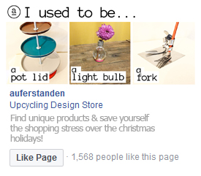
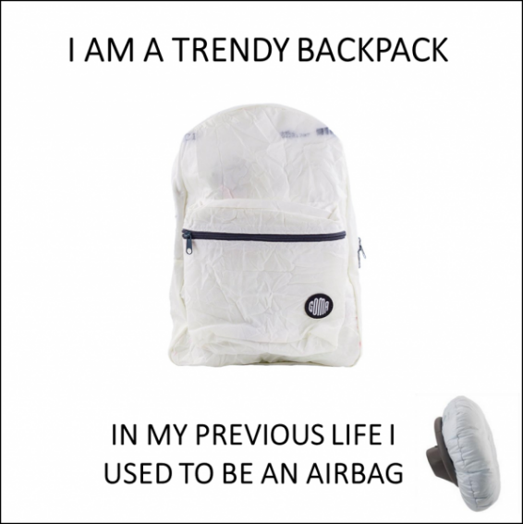
NDIVIDAL SELF
People are motivated to maintain a positive view of themselves.
Reminders of the past identity of repurposed products make consumers feel special and increases demand
B. Kamleitner, C. Thürridl, B.A.S. Martin, A cinderella story: how past identity salience boosts demand for repurposed products, J. Mark. 83 (2019) 76–92. https://doi.org/10.1177/0022242919872156

Slide 14
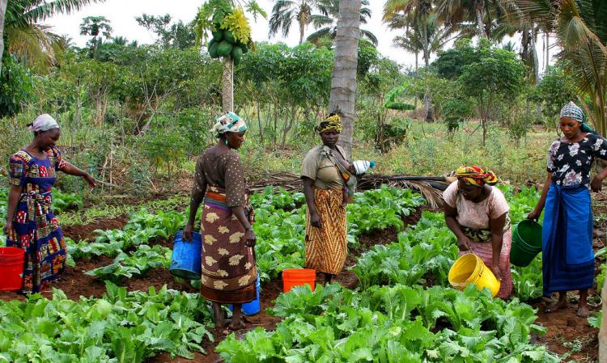
NDIVIDAL SELF
Individual differences are also important in climate-friendly decision-making.
Collective village groups in Indonesia, Peru and Tanzania conserved about 51% more trees by ensuring half of group members were women.
N.J. Cook, T. Grillos, K.P. Andersson, Gender quotas increase the equality and effectiveness of climate policy interventions, Nat. Clim. Change. 9 (2019) 330–334. https://doi.org/10.1038/s41558-019-0438-4.

Slide 15
NDIVIDAL SELF
Individual differences are also important in climate-friendly decision-making.
When men are less likely to support sustainable causes, masculine branding or affirmation can close this gender gap
Brough, A. R., Wilkie, J. E., Ma, J., Isaac, M. S., & Gal, D. (2016). Is eco-friendly unmanly? The green-feminine stereotype and its effect on sustainable consumption. Journal of Consumer Research, 43(4), 567-582.

Slide 16
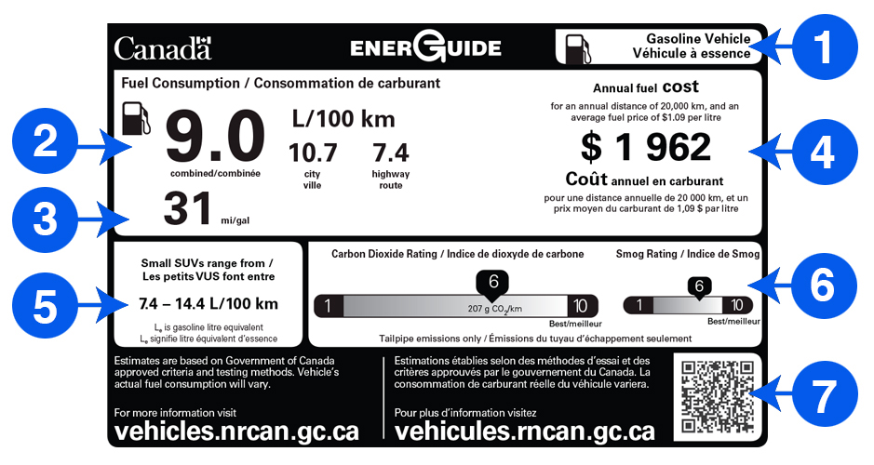
NDIVIDAL SELF
Translating the same attribute into different frames can appeal to different types of people and goals.
Individual differences are also important in climate-friendly decision-making.
Ungemach, C., Camilleri, A. R., Johnson, E. J., Larrick, R. P., & Weber, E. U. (2018). Translated attributes as choice architecture: Aligning objectives and choices through decision signposts. Management Science, 64(5), 2445-2459.

Slide 17
EELINGS AND COGNITION
Consumers are influenced both by feelings and intuition (“system 1”) and by more deliberative cognitions (“system 2”).
Positive emotions: warm glow, pride
Negative emotions: Fear, guilt
Information
Framing
Labeling

Slide 18
EELINGS AND COGNITION
Consumers are influenced by feelings and intuition (i.e., “system 1”)
Lower anticipated guilt increases demand for made-to-order products, made from recycled materials.
(More broadly, guilt appeals must be moderate.)
N. Paharia, Who receives credit or blame? The effects of made-to-order production on responses to unethical and ethical company production practices, J. Mark. 84 (2020) 88–104. https://doi.org/10.1177/0022242919887161.

Slide 19
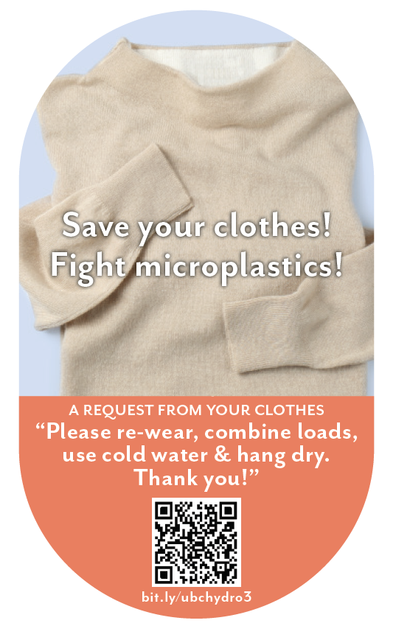
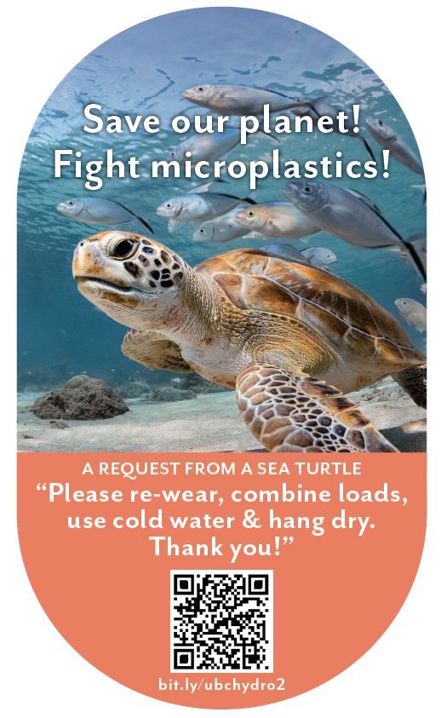
EELINGS AND COGNITION
Consumers are influenced by feelings and intuition (i.e., “system 1”)
Attractive appeals and guilt reduction sustain behavior change over time

Slide 20
EELINGS AND COGNITION
Consumers are influenced by deliberative cognitions (i.e., “system 2”).
Consumers underestimate the emissions associated with food but providing clear labels can change this and shift preferences towards low emission food.
A.R. Camilleri, R.P. Larrick, S. Hossain, D. Patino-Echeverri, Consumers underestimate the emissions associated with food but are aided by labels, Nature Climate Change. 9 (2019) 53–58. https://doi.org/10.1038/s41558-018-0354-z.

Slide 21
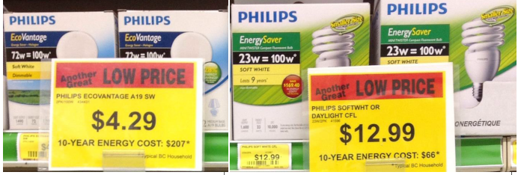
EELINGS AND COGNITION
Consumers are influenced by deliberative cognitions (i.e., “system 2”).
Labels with “10-year dollar cost” framing increased energy efficient purchases from 12% to 48%
Hardisty, D. J., Wang, W., Shim, Y., Sun, D., & Griffin, D. (working paper). Encouraging Energy Efficiency: Product Labels Activate Temporal Tradeoffs.

Slide 22
ANGIBILITY
A particularly striking feature of sustainability is that it can feel abstract and psychologically distant.
Communicate local and proximal impacts
Matching temporal focus
Encourage desire for intangibles
Concrete communications

Slide 23
ANGIBILITY
One way to increase climate conscious behavior is to make the outcomes of actions more concrete and tangible
Concrete representations of what products will become after recycling can generate greater interest in advertisements and lead to increased recycling at outdoor events and residences
K.P. Winterich, G.Y. Nenkov, G.E. Gonzales, Knowing what it makes: how product transformation salience increases recycling, J. Mark. 83 (2019) 21–37. https://doi.org/10.1177/0022242919842167.

Slide 24
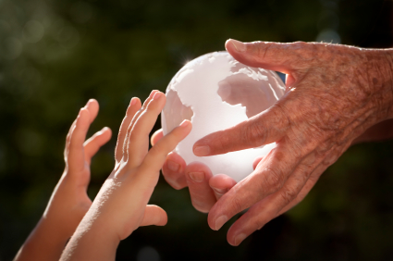
ANGIBILITY
Another way is to ask people to think more abstractly, such as about the future.
Consumers who were asked to consider their legacy (“how will I be remembered?”) donated 45% more to a climate-change charity
Zaval, L., Markowitz, E. M., & Weber, E. U. (2015). How will I be remembered? Conserving the environment for the sake of one’s legacy. Psychological science, 26(2), 231-236.
Image from https://www.iris.xyz/wp-content/uploads/2015/06/legacy.jpg

Slide 25
Notes:
0

Slide 26
Choosing a behavior
What behaviors would have the greatest impact? Think about the carbon emissions & biodiversity impacts from the behavior change.
Is “mere” choice architecture the appropriate tool here? Sometimes legal sanctions or economic incentives may be required.
Choosing a population
Consumers
Employees
Policy makers

Slide 27
Choice architecture or/and system change?
Nudging individual behaviors is a distraction and does more harm than good:
Hagmann, D., Ho, E. H., & Loewenstein, G. (2019). Nudging out support for a carbon tax. Nature Climate Change, 9(6), 484-489.
Chater, N., & Loewenstein, G. (2022). The i-frame and the s-frame: How focusing on individual-level solutions has led behavioral public policy astray. Behavioral and Brain Sciences, 1-60.
Nudging individual behaviors neither harms nor helps policy support:
Rakhimov, A., & Thulin, E. (2022). Knowing behavior matters doesn’t hurt: the effect of individual climate behavior messaging on green policy support. Oxford Open Climate Change, 2(1), kgac007.
Maki, A., Carrico, A. R., Raimi, K. T., Truelove, H. B., Araujo, B., & Yeung, K. L. (2019). Meta-analysis of pro-environmental behaviour spillover. Nature Sustainability, 2(4), 307-315.
Behavioural Science supports good policy:
Hallsworth, M. (2023). Misconceptions about the Practice of Behavioral Public Policy. Available at SSRN 4328659.
Notes:
Maki: Positive spillover was most likely when interventions targeted intrinsic motivation and when PEB1 and PEB2 were similar.

Slide 28
Thank you!
Questions or comments?
Feel free to reach out: david.hardist@sauder.ubc.ca

Slide 29
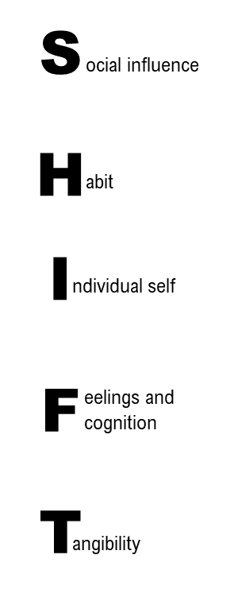
 | Stage of the Consumption Cycle
 | Choice | Usage | Disposal
 | People follow advocates who themselves engage in uncommon, non-normative behavior, such as putting up solar panels (Kraft-Todd et al. 2019). | Dynamic norms emphasizing how others are adopting new behaviors reduced water usage (Sparkman et al. 2020). | Mothers’ waste avoidance and recycling behaviors tend to encourage their children (Evans et al. 2018).
 | New sustainable habits often involve new product choices (Perera et al. 2018). | Defaults help lower meat consumption, and feedback reduces energy use (Wynes et al. 2018). | People form new habits such as food redistribution to reduce food waste (Gollnhofer 2019).
 | Consumers’ desire to view themselves positively leads to forgetting unethical attributes more than ethical ones (Reczek et al. 2018) | Higher status is associated with lower energy conservation (Wang et al. 2019). | Reminders of the past identity of repurposed products make consumers feel special and increases demand (Kamleitner et al. 2019).
 | People’s intuition that ethical products are less strong reduces choice share (Mai et al. 2019). | Using green products is more enjoyable than using traditional products (Tezer and Bodur 2020). | Lower anticipated guilt increases demand for made-to-order products, made from recycled materials (Paharia 2020).
 | Detailed, concrete information about sustainability can increase choice of eco-friendly products (Reczek et al. 2020). | Experiencing heatwaves can lead to perceptions of energy scarcity (Larcom et al. 2015). | Concrete representations of what products can become encourage recycling (Winterich et al. 2019).

